Slide 1
OpenAI GPT-3

Slide 2
Agenda:
What is GPT-3?
Demo: Build a paraphraser, Chatbot, Summarization
OpenAI playground to develop prompts.
Understand various engines and GPT-3 prompt parameters.
Create novel datasets with GPT-3 and Streamlit UI.
Zero-shot and few-shot prompts.
Fine tuning GPT3

Slide 3
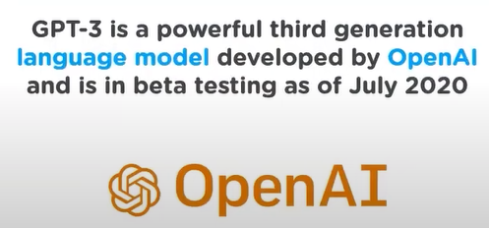
What is GPT-3?
Generative Pre-trained Transformer 3 is an autoregressive language model that uses deep learning to produce human-like text. Given an initial text as prompt, it will produce text that continues the prompt.
It is a language model trained by OpenAI to predict the next word.
Input is text and the output is text.

Slide 4
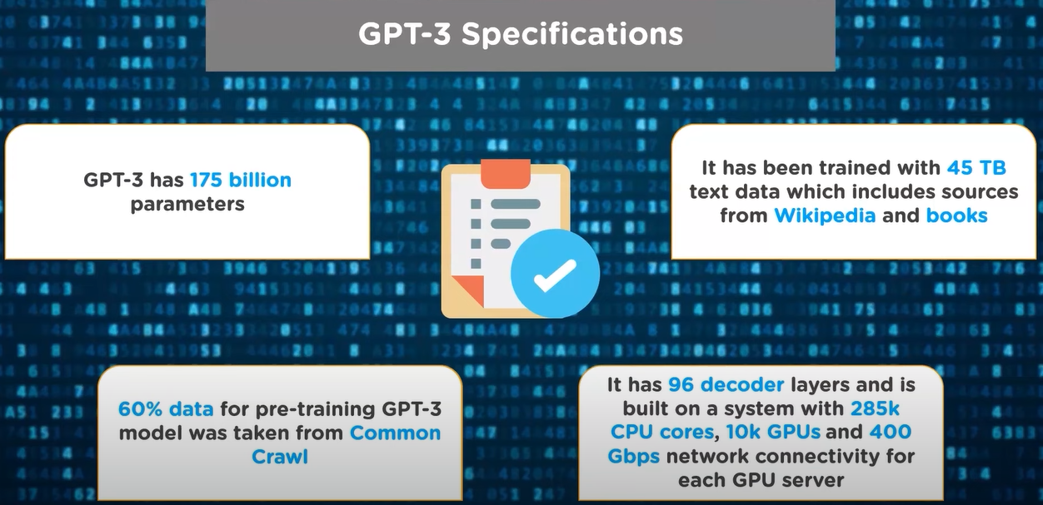
GPT-3 Specifications

Slide 5
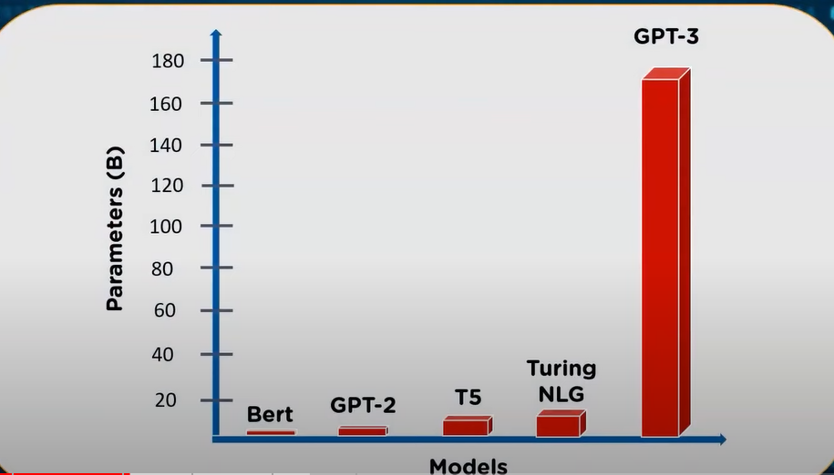
Models vs Parameters

Slide 6
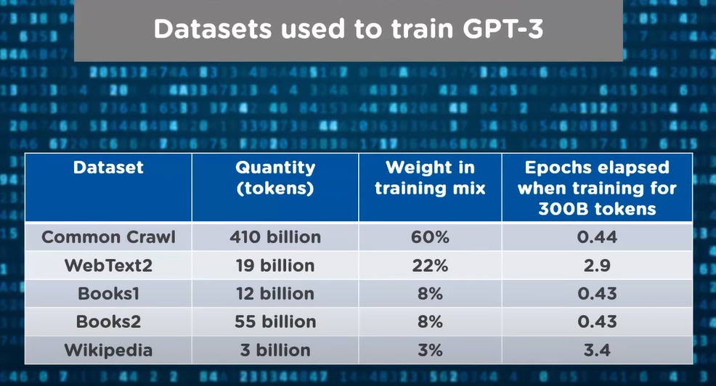
Datasets used to train GPT-3

Slide 7
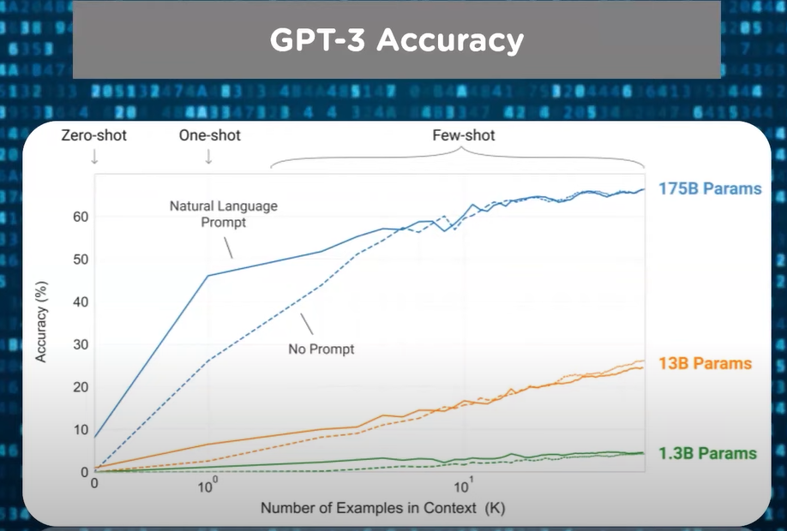
GPT-3 Accuracy

Slide 8
What is a language model?
Predict Next word
As a child in Gotham City, Bruce Wayne falls down a dry well and is attacked by a swarm of bats, developing a ______(fear)
As a child in Gotham City, Bruce Wayne falls down a dry well and is attacked by a swarm of bats, developing a fear of them. Attending the opera with his parents, Thomas and Martha, Bruce becomes frightened by performers masquerading as bats and asks to _____ (leave)
Note: The longer the context the better you get at predicting next word

Slide 9
What is a prompt and response?
Prompt is the input text to GPT-3.
Eg: The earth revolves around the
The response is the output text by GPT-3 to the input prompt.
Eg: The earth revolves around the Sun.

Slide 10
What is a prompt engineering?
Mastering the art of giving clear input text (instructions) to GPT-3 such that it generates desired output is called prompt engineering.

Slide 11
GPT-3 Playground
GPT-3 playground overview
Show presets
Base Demo
Tokens - Introduction and demo
Tokens Demo: https://beta.openai.com/tokenizer

Slide 12
GPT-3 Engines and Parameters
Different engines and pricing
https://beta.openai.com/pricing
GPT-3 parameters. Show probabilities and explain.

Slide 13
Create paraphrase dataset with GPT-3
Paraphrase dataset creation demo in the playground.
Paraphrase dataset demo in Google Colab and Streamlit Visualization.

Slide 14
Zero-shot and Few-shot Prompts & its demo
Zero-shot: The input prompt doesn't contain any examples of the task but just a description of the target task to be achieved.
Few-shot: The input prompt contains one or more examples of the task to be achieved.

Slide 15
Fine Tune GPT-3
Classification demo

